Slide 1
AI Strategy and Governance
Introduction to AI Strategy
Kartik Hosanagar, Professor of Operations, Information and Decisions

Slide 2
Course Introduction
AI-Driven Business Transformation
Developing a Portfolio of AI Projects
Lowering Barriers for AI Use
AI in the Organization Structure
AI and Change Management
Risks with AI
AI Governance

Slide 3
AI Strategy and Governance
AI-Driven Business Transformation
Kartik Hosanagar, Professor of Operations, Information and Decisions

Slide 4

AI: An Opportunity and a Risk
AI is viewed by business leaders as both an opportunity and a risk
From a 2019 BCG/MIT report:
9/10
45%
companies feel AI presents a business opportunity
of companies feel AI poses some business risk
“what if competitors, particularly new entrants, figure out AI before we do?”
Driven by the opportunities and risks, companies in many industries have announced AI initiatives
Content/quotes from: https://sloanreview.mit.edu/projects/winning-with-ai/?fbclid=IwAR3vpFQ0bPE1CK9kf8Mm07tleOO1eB5urQ9OdYOo7Lwcunxh6VbeamgGT6Q

Slide 5
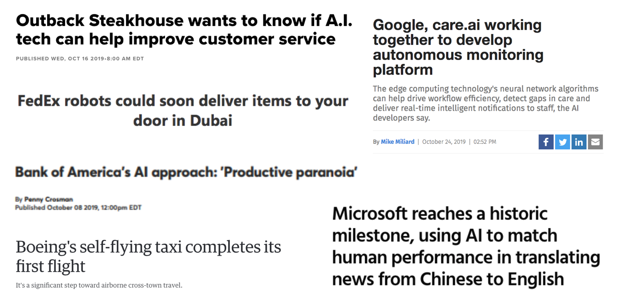
AI Applications are Everywhere
Images: https://www.cnbc.com/2019/10/16/outback-steakhouse-is-testing-ai-to-help-improve-customer-service.html, https://www.msn.com/en-ae/news/techandscience/fedex-robots-could-soon-deliver-items-to-your-door-in-dubai/ar-AAIVh78, https://www.americanbanker.com/news/bank-of-americas-ai-approach-productive-paranoia, https://www.engadget.com/2019/01/23/boeing-autonomous-flying-taxi-completes-flight/, https://www.healthcareitnews.com/news/google-careai-working-together-develop-autonomous-monitoring-platform, https://thetechrevolutionist.com/2018/03/microsoft-reaches-historic-milestone.html

Slide 6
AI Application Challenges
In a 2019 MIT/BCG study, 90% of companies surveyed had made investments in AI
However, a subset of the 90% that invested in AI made significant investments
Looking just at this subset that invested significantly, only
Of this group, only
40%
60%
saw business gains from AI over the last 3 years
saw business gains from AI over the last 3 years
Content/quotes from: https://sloanreview.mit.edu/projects/winning-with-ai/?fbclid=IwAR3vpFQ0bPE1CK9kf8Mm07tleOO1eB5urQ9OdYOo7Lwcunxh6VbeamgGT6Q

Slide 7
Early Failures Can Lead to Irrational Retreats
Many companies started online divisions due to the internet. There were some early successes but many more failures. This led companies to shut down/scale back their efforts, which allowed startups to disrupt their industries.
This pattern is likely to repeat itself with AI. So how should companies approach AI to avoid falling into the pattern of early failure leading to irrational retreats?
Internet
Cloud Computing
Mobile Computing
AI
Late 1990s
Mid 2000s
Late 2000s
Now
A similar pattern of early failures followed by irrational retreats happened with cloud computing. The companies that continued with the cloud are doing well, while those that retreated are still catching up.
Content/quotes from: https://hbr.org/2017/04/the-first-wave-of-corporate-ai-is-doomed-to-fail

Slide 8
AI Strategy and Governance
Developing a Portfolio of AI Projects
Kartik Hosanagar, Professor of Operations, Information and Decisions

Slide 9
A Portfolio Approach to AI
A portfolio approach can help companies successfully unleash the power of machine intelligence
redefine end-to-end processes
AI Portfolio = Quick Wins + Long Term Projects
optimization at a touch point
Content/quotes from: https://hbr.org/2017/04/the-first-wave-of-corporate-ai-is-doomed-to-fail

Slide 10
Quick Wins
Quick wins focus on applying off-the-shelf ML (with suitable adaptations) to internal employee touchpoints
These projects won’t transform the business, but they serve to expose employees to the benefits of AI and build consensus on its potential
They also allow companies to build the skills they need for larger AI projects, such as “large-scale data gathering, processing, and labeling”
Some examples of quick wins include:
“a voice interface to help pharmacists look up substitute drugs”
“a tool to schedule internal meetings”
Content/quotes from: https://hbr.org/2017/04/the-first-wave-of-corporate-ai-is-doomed-to-fail

Slide 11
Long-Term Projects
Long-term projects are likely to be the most impactful because they involve rethinking end-to-end processes, not just focusing on point optimization
An example of a long-term project for an insurance company could be automating claims processing through speech and vision understanding
Many car insurance companies already allows users to take photos of auto damage and settle their claims on a mobile app
Technology that’s been trained on photos from past claims can accurately estimate the extent of the damage and automate the whole process
Because long-term projects are more involved than quick wins, off-the-shelf technology doesn’t suffice
Long-term projects generally require organizational skills in building ML algorithms
Content/quotes from: https://hbr.org/2017/04/the-first-wave-of-corporate-ai-is-doomed-to-fail

Slide 12
Example of a Portfolio Approach: Google
Google initially focused on incorporating ML into a few components of systems, but is moving towards using ML to replace entire systems
Google started with smaller projects and moved towards rethinking complete processes. Some examples include:
Gmail’s Smart Reply
Data Center Cooling
Google Photos
Employee Retraining
Content/quotes from: https://backchannel.com/how-google-is-remaking-itself-as-a-machine-learning-first-company-ada63defcb70

Slide 13
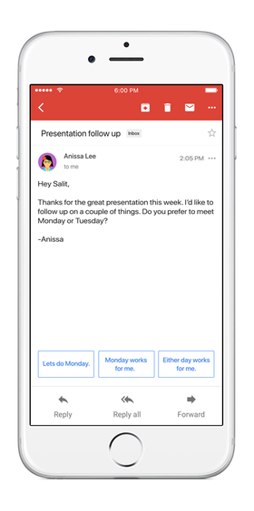
Gmail’s Smart Reply
What is Smart Reply?
Gmail feature that uses ML to provide email response options, where users can choose from these instead of typing out their own response
How does Smart Reply work?
It uses ML - the system looks at past responses and based on that data tries to predict what responses a person is likely to type
Content/quotes from: https://backchannel.com/how-google-is-remaking-itself-as-a-machine-learning-first-company-ada63defcb70
Images: https://time.com/4785732/gmail-google-smart-reply/

Slide 14


Google Photos
How does Google Photos use machine learning?
It uses ML to find images of things users request, based on an understanding of the picture’s content
If someone asks for pictures of border collies, the computer “knows what a border collie looks like, and it will find pictures of it when it’s a puppy, when its old, when its long-haired, and when it’s shorn”
Content/quotes from: https://backchannel.com/how-google-is-remaking-itself-as-a-machine-learning-first-company-ada63defcb70, Images: https://gadgets.ndtv.com/apps/news/google-photos-automatic-brightness-image-rotation-archive-suggestions-1853364, https://www.akc.org/dog-breeds/border-collie/

Slide 15
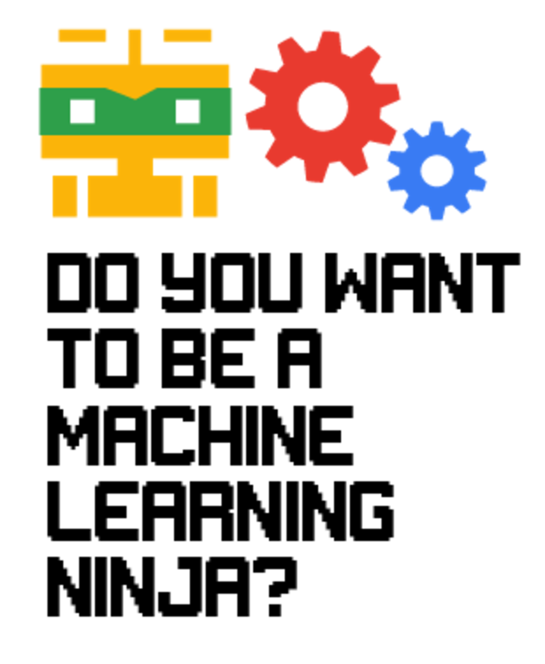
Google’s Engineer Training
To ensure this transformation with ML, Google embarked on internal training programs for training 25K engineers in ML
Invites employees to spend 6 months embedded in ML team with a mentor
Then distributes these experts into all product teams in the interest of creating organizational learning
Content/quotes from: https://backchannel.com/how-google-is-remaking-itself-as-a-machine-learning-first-company-ada63defcb70

Slide 16
Suggested Exercise (Individual or Group)
Identify a set of activities within your organization that you can automate using ML
Classify them into short-term and long-term initiatives
Construct a 3-year ML portfolio consisting of 5-6 short-term projects and 1-2 long-term projects
Figure out how the AI team will fit into the organization chart
Is it a separate group within the organization or does it fit into engineering or a product team?

Slide 17
AI Strategy and Governance
Lowering Barriers for AI Use
Kartik Hosanagar, Professor of Operations, Information and Decisions

Slide 18
Democratization of ML
Training/upskilling employees over time is important, but other resources also exist to help companies start developing their AI project portfolios
Resources that are democratizing ML
1
Hardware (specialized chipsets and scalable computing platforms)
2
Software (open-source frameworks and developer tools)
3
Data & Algorithms (marketplaces)
Content/quotes from: https://hbr.org/2017/04/the-first-wave-of-corporate-ai-is-doomed-to-fail

Slide 19
Hardware
1
Specialized chipsets and scalable computing platforms
Google’s Tensor Processing Unit (TPU)
NVIDIA’s DGX-1
Amazon Web Services (AWS)
Google Cloud Platform
Microsoft Azure + more
This specialized hardware and scalable infrastructure is available for rent at a low cost, which puts machine learning within reach for more organizations
Content/quotes from: https://hbr.org/2017/04/the-first-wave-of-corporate-ai-is-doomed-to-fail

Slide 20
Software
2
Open-source frameworks and developer tools
Google’s Tensor Flow
Apache’s MXNet
Facebook’s Torch
Microsoft Azure ML Studio
Amazon/Google Platforms
These increasingly accessible tools help automate the data science process and allow software engineers to also contribute to data science efforts
Content/quotes from: https://hbr.org/2017/04/the-first-wave-of-corporate-ai-is-doomed-to-fail

Slide 21
Data and Algorithms
3
Marketplaces for data and algorithms
Algorithmia
Kaggle
Exchange.ai
And many more…
This indicates that hiring shouldn’t be frontloaded, but rather undertaken slowly and consistently
“Making use of marketplaces for machine learning software and infrastructure can help keep costs manageable”
Content/quotes from: https://hbr.org/2017/04/the-first-wave-of-corporate-ai-is-doomed-to-fail

Slide 22
AI Strategy and Governance
Economics of AI: Introduction
Prasanna (Sonny) Tambe, Associate Professor of Operations, Information and Decisions

Slide 23
AI Strategy and Governance
Economics of AI: Software
Prasanna (Sonny) Tambe, Associate Professor of Operations, Information and Decisions

Slide 24
Key Inputs to AI
Software
Skills
Computation
Data

Slide 25

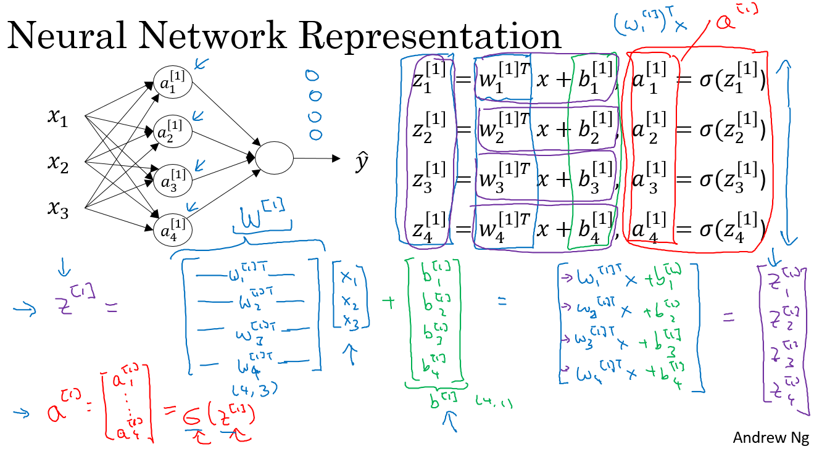
Software
AI is incredibly powerful, but programming a neural network can be relatively difficult
Requires a high level of expertise
Hiring PhD’s is expensive
The kind of math required to put together a neural network is advanced
AI’s commercial impact has been limited by its “price” — it’s expensive to implement

Slide 26

Deep Learning Goes Open Source
In November 2015, Google released TensorFlow
TensorFlow is one of several closely related deep learning frameworks
Torch, Keras, Caffe, Theano

Slide 27
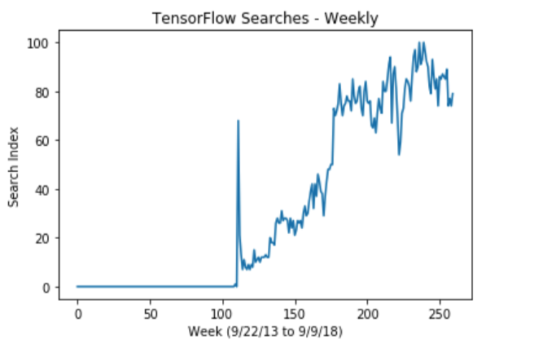
TensorFlow
Immediate interest and uptake

Slide 28
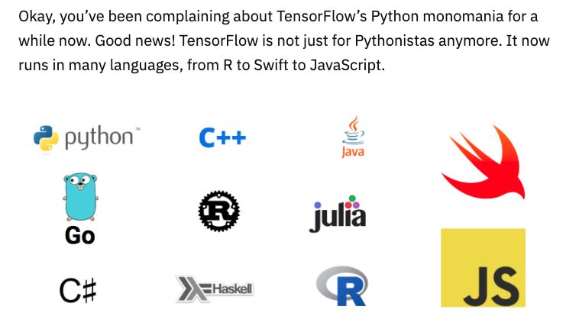
TensorFlow
Available for many platforms

Slide 29
TensorFlow
Makes it much easier to create and deploy neural networks
Why did Google open source TensorFlow?
Encourage others to collaborate and contribute back to the TensorFlow package
Talent pipeline
Selling complementary services

Slide 30
AI Strategy and Governance
Economics of AI: Skills
Prasanna (Sonny) Tambe, Associate Professor of Operations, Information and Decisions

Slide 31
New Tools and Interfaces
Release of TensorFlow and similar packages significantly changes the talent profile that firms need to implement deep learning solutions
Becoming even easier to use deep learning software
Better user interfaces are being developed to take advantage of these types of frameworks

Slide 32
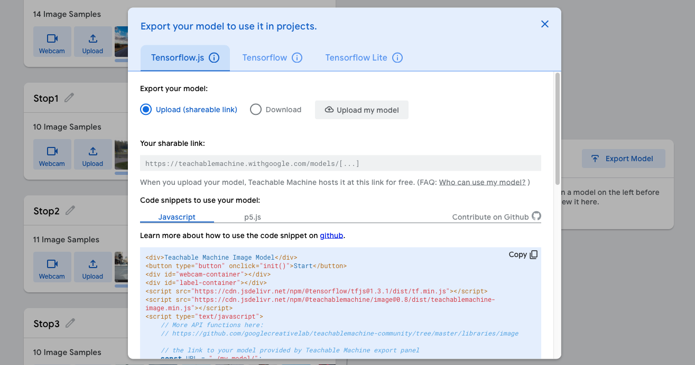
No-code Tools: Teachable Machine

Slide 33
New Tools and Interfaces
Further lowers entry barriers for applying ML algorithms
Ever easier to deploy AI applications, even with little coding background
Makes it easier for AI ideas and innovation to be realized

Slide 34
New Tools and Interfaces
Easier than ever for employees in different sectors or different verticals (marketing, finance, HR) to engage directly with AI
As we remove the “skills” bottleneck, what’s next?
Data and computation

Slide 35
AI Strategy and Governance
Economics of AI: Compute
Prasanna (Sonny) Tambe, Associate Professor of Operations, Information and Decisions

Slide 36
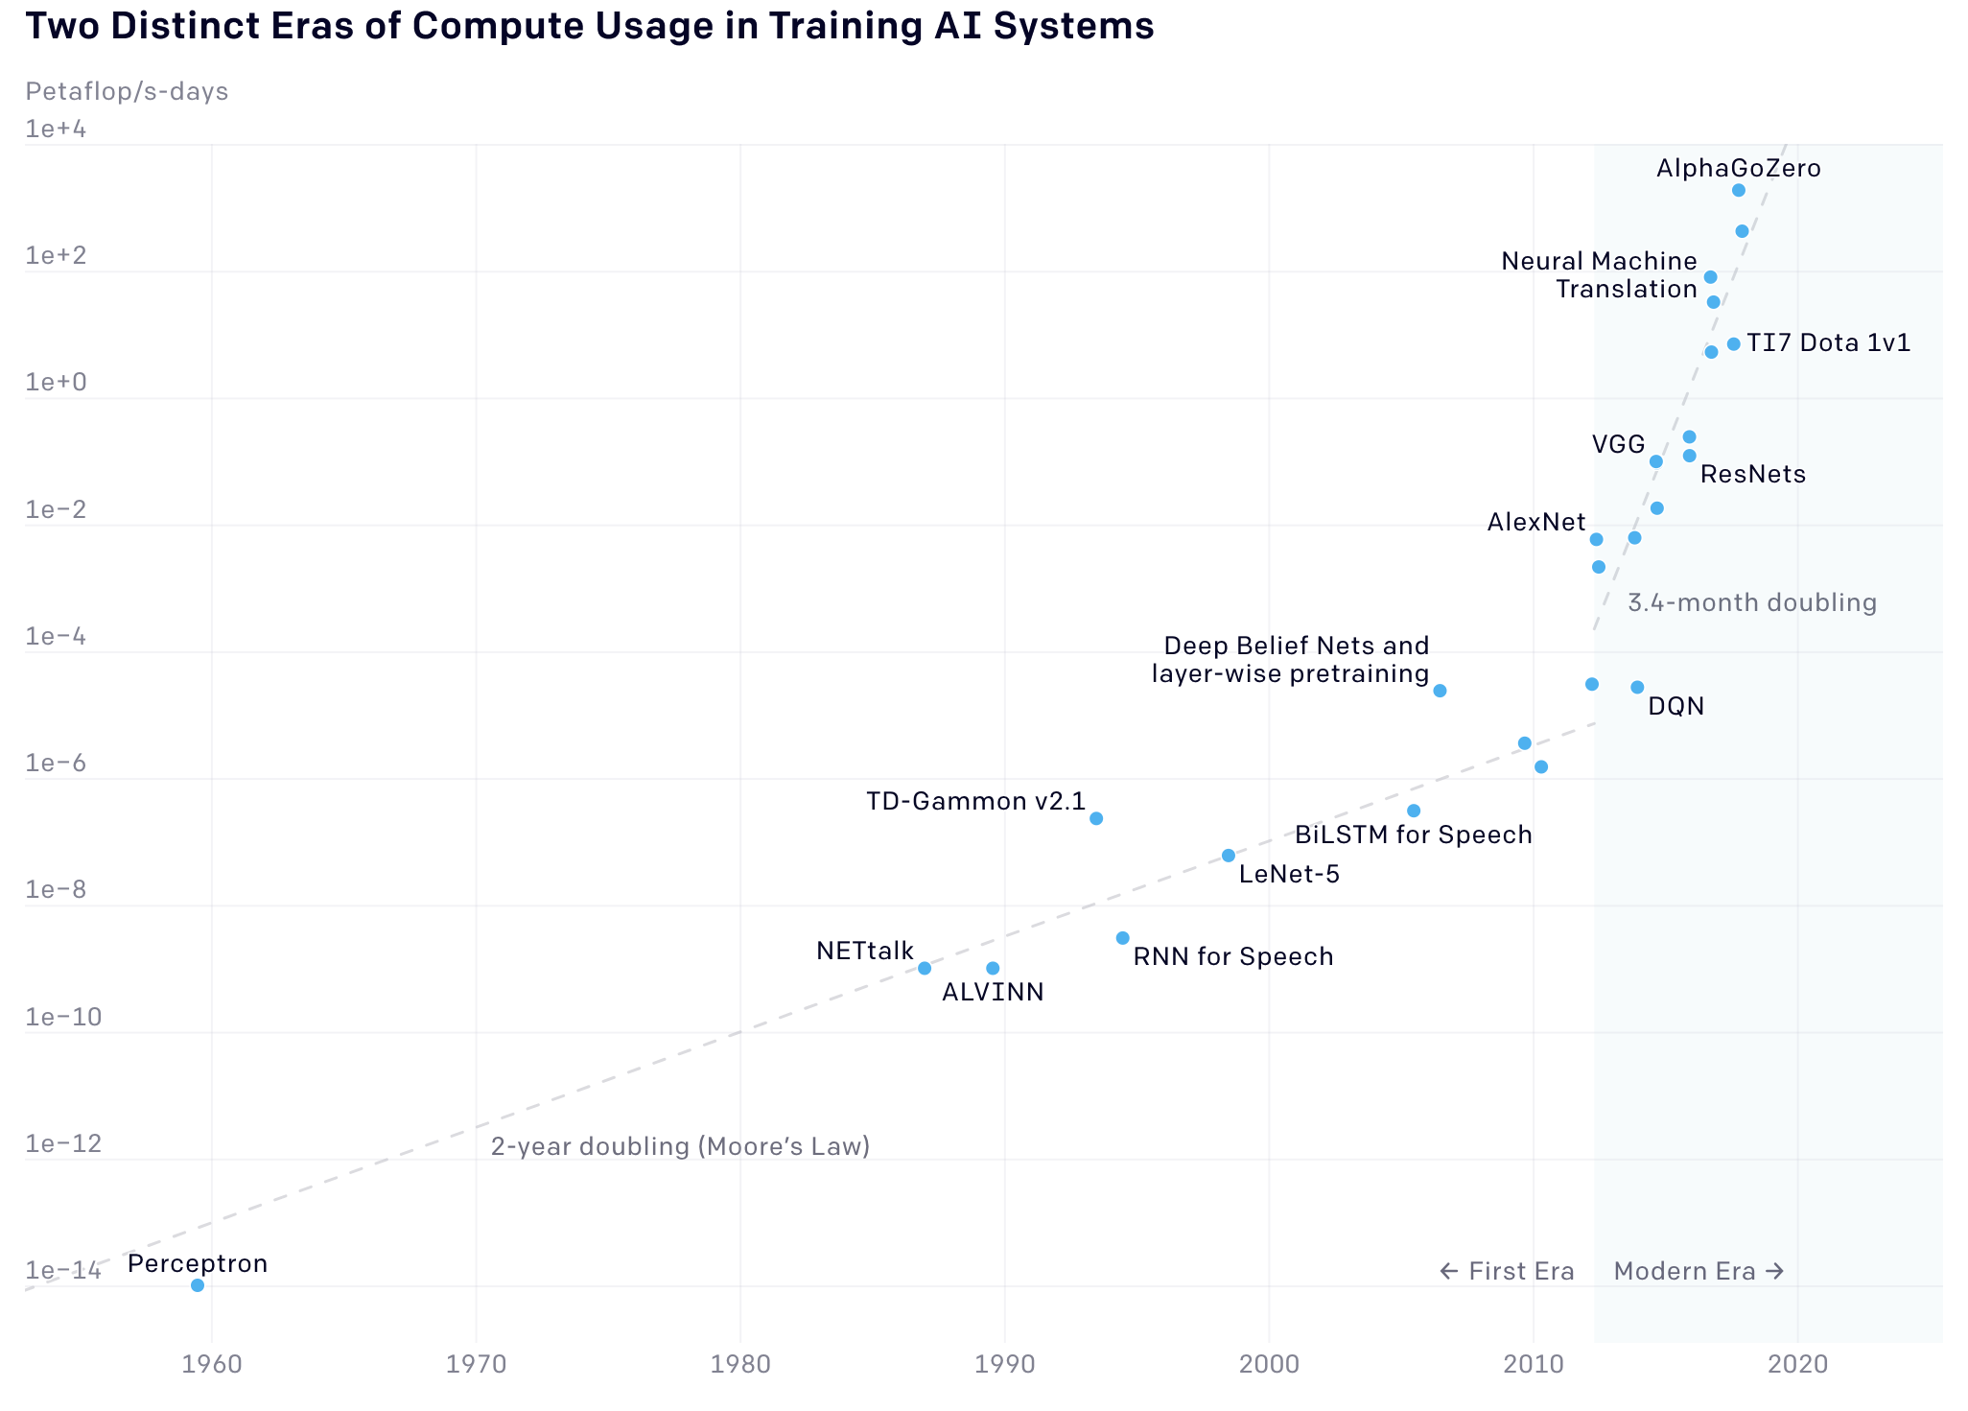
Moore’s Law Has Driven Decades of Tech Progress

Slide 37
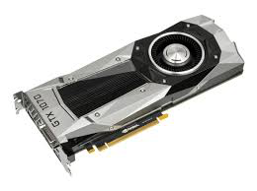
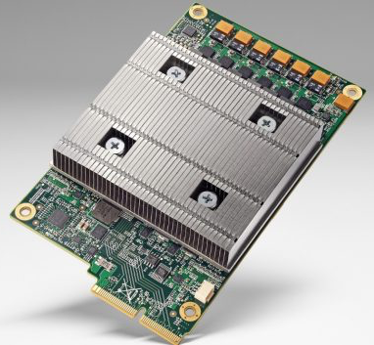
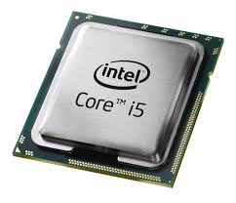
Moore’s Law Has Driven Decades of Tech Progress
Computational demands for ML are outpacing these computing improvements
In response, deep learning hardware is becoming better and increasingly specialized
CPU
GPU
TPU

Slide 38

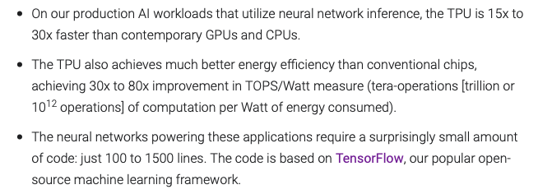
Google’s TPU

Slide 39
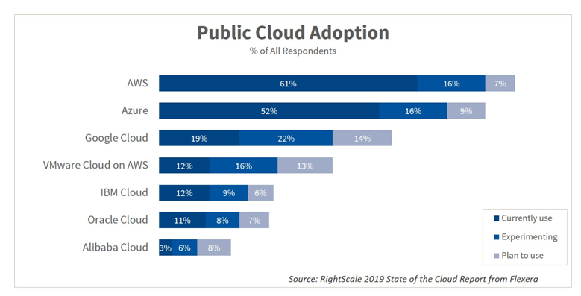
Emerging Battle for the AI Stack

Slide 40
AI Strategy and Governance
Economics of AI: Data
Prasanna (Sonny) Tambe, Associate Professor of Operations, Information and Decisions

Slide 41
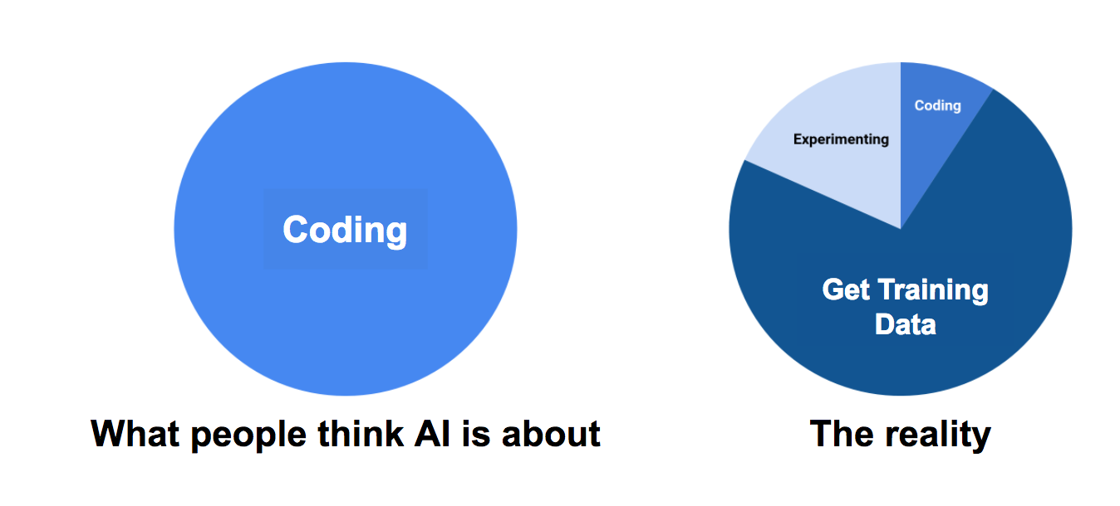
Training Data is the Key to ML Applications
Coding
Experimenting
Coding
Training Data
What people think AI is about
The reality

Slide 42
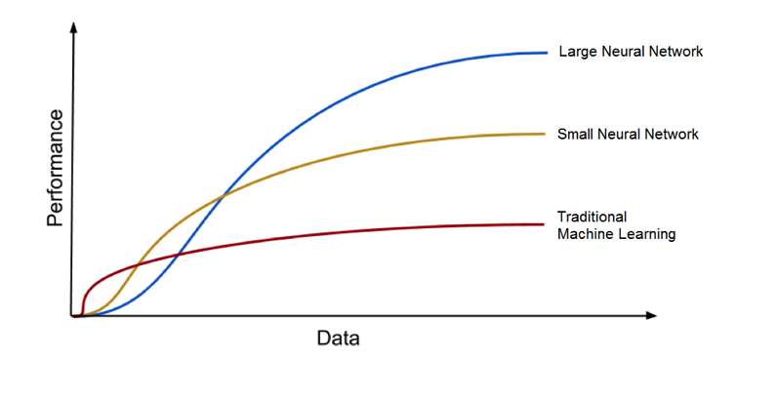
Value of Data Scale Tied to Deep Learning

Slide 43
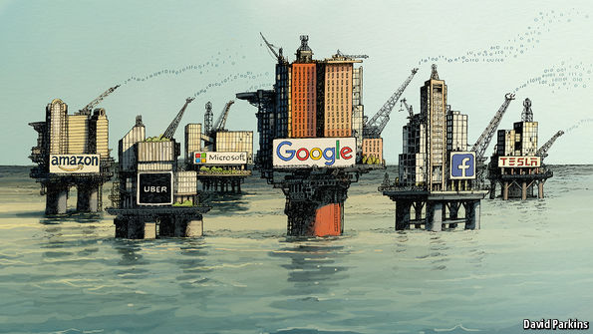
“Data is the New Oil”

Slide 44
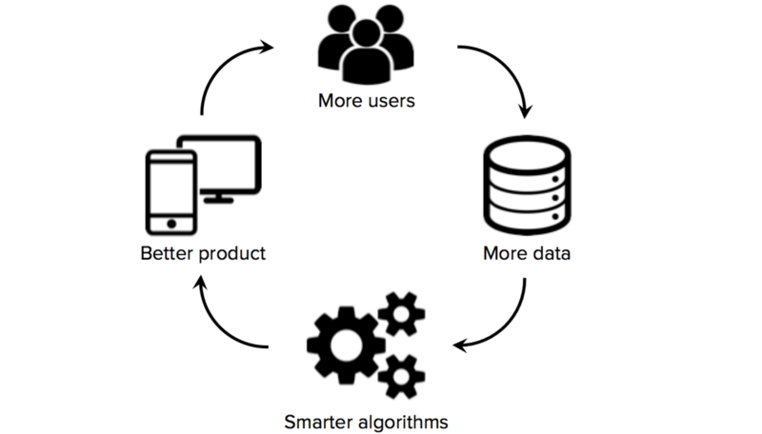
Data
Some firms have massive stores of data assets
Buying patterns, search data, travel data…
Virtuous cycle of data collection means the rich get richer

Slide 45
AI Strategy and Governance
Economics of AI: AutoML
Prasanna (Sonny) Tambe, Associate Professor of Operations, Information and Decisions

Slide 46
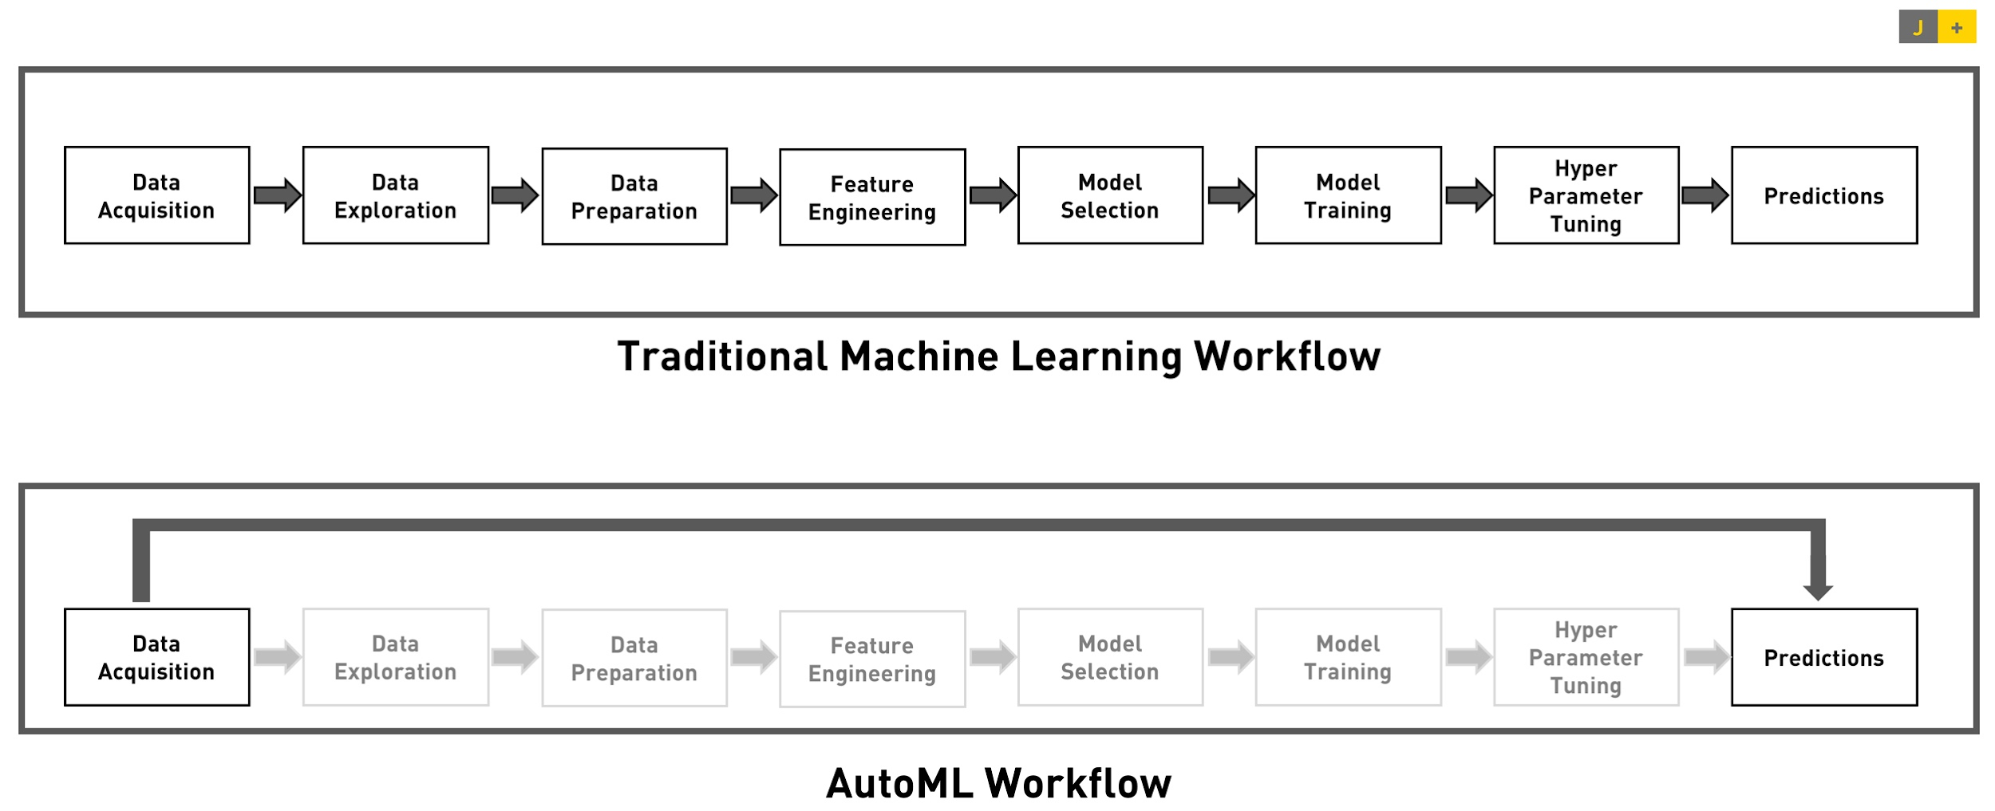
AutoML

Slide 47
AutoML
Developed by Google
Idea is that “computational power could replace the need for machine learning expertise”
Only have to upload the data in the right format
One option left — train model
Makes the process incredibly easy to implement, but very heavy on computational resources

Slide 48
Many Variants of “AutoML” Are Emerging
Microsoft Automated ML
Amazon Sagemaker AutoPilot
IBM AutoAI

Slide 49
Many Variants of “AutoML” Are Emerging
Further implications for the market for ML skills, computation, and data
Moving to an ecosystem where anyone can deploy AI solutions
Higher demand for computation and for data assets, and for people who can contextualize and interpret AI

Slide 50
AI Strategy and Governance
Economics of AI: AutoML Hubris
Prasanna (Sonny) Tambe, Associate Professor of Operations, Information and Decisions

Slide 51
Can AI Be Too Easy?
Issues related to bias, potential misuse, etc., may be amplified with users who have little or no understanding of how algorithms are built
There are a number of concerns about AutoML “hubris”
The notion that a lack of understanding about the inner workings will lead to problems
Likely to fuel a rapid increase in demand for AI ethicists and others who can grapple with the implications of algorithmic decisions

Slide 52
AI Strategy and Governance
Economics of AI: Competitive Implications
Prasanna (Sonny) Tambe, Associate Professor of Operations, Information and Decisions

Slide 53
Implications of a Growing Emphasis on Data and Computation
Troubling scale economies
Firms or organizations with better data are able to collect better data in turn — virtuous cycle
Platform effects wherein the rich get richer

Slide 54
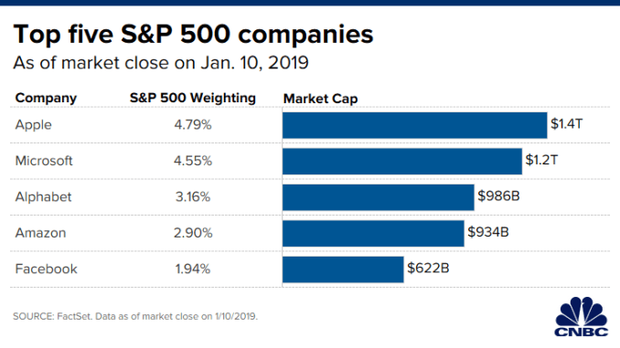
Implications of a Growing Emphasis on Data and Computation
Concentration and market share are growing in a small set of firms

Slide 55
Implications of a Growing Emphasis on Data and Computation
Pendulum of public opinion has begun to swing back
How we feel about their use of our personal data to make recommendations or develop products
Data portability (The ACCESS act)

Slide 56
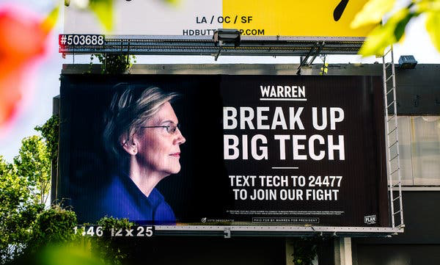
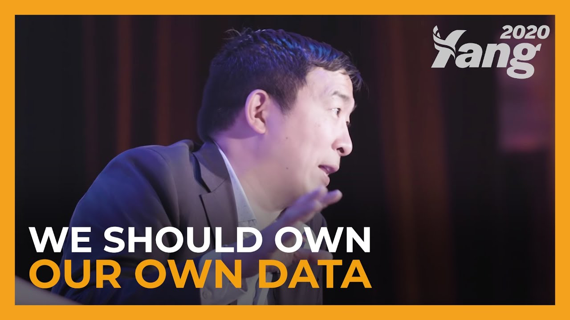
Implications of a Growing Emphasis on Data and Computation

Slide 57
AI Strategy and Governance
Interview with Apoorv Saxena
Kartik Hosanagar, Professor of Operations, Information and Decisions

Slide 58
AI Strategy and Governance
AI in the Organization Structure
Kartik Hosanagar, Professor of Operations, Information and Decisions

Slide 59
Organizational Behaviors
Why are some companies more successful than others at generating value from AI?
AI strategy integration
Taking risks and growing revenue
AI unification/investing in data and process change
Aligning AI production and consumption
Investing in talent
Content/quotes from: https://sloanreview.mit.edu/projects/winning-with-ai/?fbclid=IwAR3vpFQ0bPE1CK9kf8Mm07tleOO1eB5urQ9OdYOo7Lwcunxh6VbeamgGT6Q

Slide 60
AI Strategy Integration
Idea: Integrate the AI strategy into the broader organizational strategy
Less Effective Approach
More Effective Approach
Develop a strategy for AI specifically
Think of using AI as a goal in and of itself
Focus on AI’s role in particular projects
Separate AI initiatives from digital initiatives
Tie AI strategy into overall strategy
Think of AI as a tool to reach existing objectives
Focus on AI’s effects on business models
Integrate AI initiatives into digital initiatives
Integration is key over the long term, but companies do “start with less ambitious goals as precursors to bigger ones or as ways to achieve early wins and gain momentum”
Content/quotes from: https://sloanreview.mit.edu/projects/winning-with-ai/?fbclid=IwAR3vpFQ0bPE1CK9kf8Mm07tleOO1eB5urQ9OdYOo7Lwcunxh6VbeamgGT6Q

Slide 61
Taking Risks and Growing Revenue
Organizations that are most effective at obtaining value from AI focus on revenue and growth side rather than on the cost side alone
Less Effective Approach
More Effective Approach
Focus on AI’s role in cutting cost & improving productivity
Invest primarily in low-risk projects
Focus primarily on AI’s role in generating revenue
Invest in higher-risk, higher-return projects
23%
50%
of those investing in low-risk projects see value from AI
of those investing in high-risk projects see value from AI
Content/quotes from: https://sloanreview.mit.edu/projects/winning-with-ai/?fbclid=IwAR3vpFQ0bPE1CK9kf8Mm07tleOO1eB5urQ9OdYOo7Lwcunxh6VbeamgGT6Q

Slide 62
AI Unification and Investing in Data & Process Change
In order to succeed with AI, the right data infrastructure must be in place
Less Effective Approach
More Effective Approach
Data remains siloed in various departments across the organization
Organizations “integrate their data, processes and behaviors to exploit AI opportunities”
Based on this integration & use of AI, the organization gains new advantages
Content/quotes from: https://sloanreview.mit.edu/projects/winning-with-ai/?fbclid=IwAR3vpFQ0bPE1CK9kf8Mm07tleOO1eB5urQ9OdYOo7Lwcunxh6VbeamgGT6Q

Slide 63
Aligning AI Production and Consumption
Organizations should be thinking not just of producing AI, but also of consuming AI as an organization
Less Effective Approach
More Effective Approach
Invest mostly in developing/producing AI algorithms
Also invest in the consumption of AI
Managers who are going to consume the insights of the data science of the machine learning and make managerial decisions from it
Content/quotes from: https://sloanreview.mit.edu/projects/winning-with-ai/?fbclid=IwAR3vpFQ0bPE1CK9kf8Mm07tleOO1eB5urQ9OdYOo7Lwcunxh6VbeamgGT6Q

Slide 64
Investing in Talent
Both hiring & upskilling are important, as “companies that hire, rent and cultivate AI talent are more likely to derive value from their AI initiatives”
Less Effective Approach
More Effective Approach
Relying on a single approach to building AI talent
Either on internal employees or external hires
Taking a “diversified approach to AI talent”
Re-skilling internal employees through trainings as well as hiring “outside experts to lead AI development”
Content/quotes from: https://sloanreview.mit.edu/projects/winning-with-ai/?fbclid=IwAR3vpFQ0bPE1CK9kf8Mm07tleOO1eB5urQ9OdYOo7Lwcunxh6VbeamgGT6Q

Slide 65
Business Transformations with AI
Create organizational learning
Embrace a portfolio approach
Integrating
AI strategy
Creating a data infrastructure
Manage new AI-specific risks

Slide 66


